Slide 1
Road Sign Recognition Employing a CNN
Charles Li, Marvin Larweh, Maximus Berner, Qing Yan

Slide 2
The Motivation.
Quickly abstracting accurate information from traffic signs is an essential task for safe and lawful driving – making it a baseline prerequisite for automated vehicles.

Slide 3
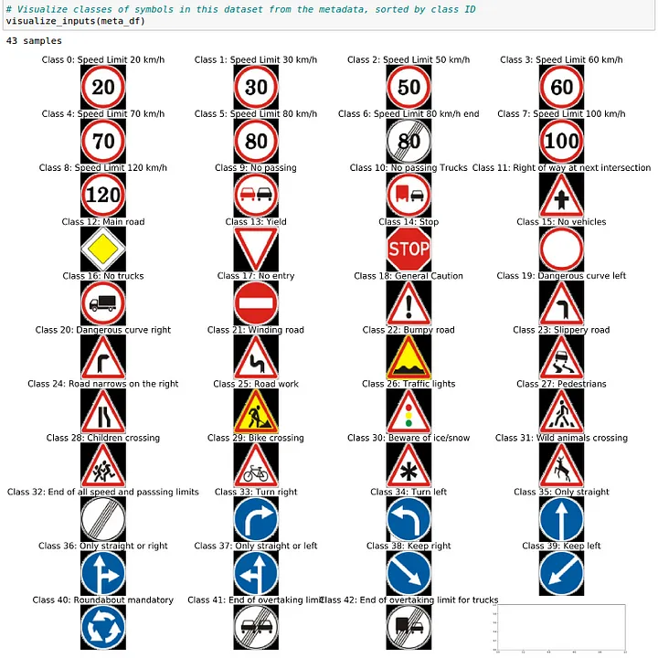





Our Project
We aimed to develop a convolutional neural network (CNN) which can accurately identify road signs.
The program accepts a still image of road sign as input and produces a classification of the sign as output.
We trained the CNN on the German Traffic Sign Recognition Benchmark for its extensive annotated dataset and history of reproducibility.
Example images from dataset

Slide 4
Initial CNN Implementation
Input Layer (30x30x3)
Images are 30x30 pixels with RGB values.
x2 Convolutional Layers [32 3x3 filters]
→ Attempt to extract low-level features (i.e basic patterns).
Max Pooling
→ Decrease computational load, abstract general features, reduce overfitting.
x2 Convolutional Layers [64 3x3 filters]
→ Attempt to extract high-level features (i.e. complex patterns).
Max Pooling → See above.
Flattening → Convert into 1D Vector.
Dense 256 → Reduce into 256 neurons with compacted information.
Dropout 0.5 → Reduce overfitting by randomly dropping 50% of neurons.
Dense 43 → Reduce into 43 neurons (final classification).
We used the ReLU activation function across the entire model.
Notes:
Input: 30x30x3 image.
First Convolutional Layer: 28x28x32 (after applying 32 filters of size 3x3).
Second Convolutional Layer: 28x28x32 (with padding='same').
First Max Pooling: 14x14x32 (downsampling with 2x2 pool).
Third Convolutional Layer: 14x14x64 (applying 64 filters of size 3x3).
Fourth Convolutional Layer: 14x14x64 (with padding='same').
Second Max Pooling: 7x7x64 (downsampling with 2x2 pool).
Flatten: 3136 (flattening the feature map).
Fully Connected Layer 1: 256 (dense layer with 256 neurons).
Dropout: Randomly drops 50% of neurons to prevent overfitting.
Output Layer: 43 (softmax activation for multi-class classification).

Slide 5
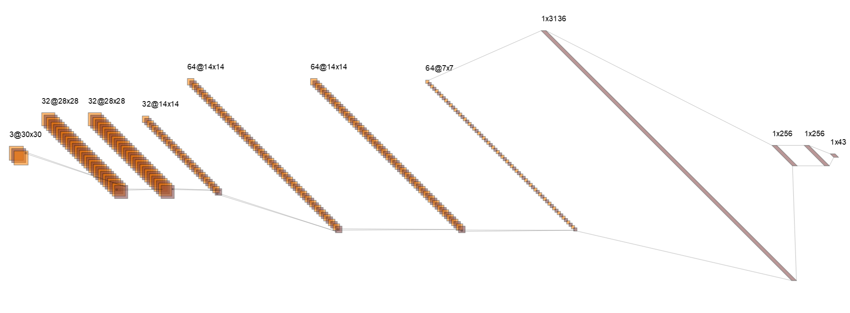
Initial CNN Visualization (NN-SVG)
Input → Conv2D(32,(3x3)) → Conv2D(32,(3x3)) → MaxPool(2x2) → Conv2D(64,(3x3)) → Conv2D(64,(3x3)) →MaxPool(2x2) → Flatten → Dense(256) → Dropout(0.5) → Dense(43)
Notes:
Input: 30x30x3 image.
First Convolutional Layer: 28x28x32 (after applying 32 filters of size 3x3).
Second Convolutional Layer: 28x28x32 (with padding='same').
First Max Pooling: 14x14x32 (downsampling with 2x2 pool).
Third Convolutional Layer: 14x14x64 (applying 64 filters of size 3x3).
Fourth Convolutional Layer: 14x14x64 (with padding='same').
Second Max Pooling: 7x7x64 (downsampling with 2x2 pool).
Flatten: 3136 (flattening the feature map).
Fully Connected Layer 1: 256 (dense layer with 256 neurons).
Dropout: Randomly drops 50% of neurons to prevent overfitting.
Output Layer: 43 (softmax activation for multi-class classification).

Slide 6
CNN Structure and Parameter Tuning
To improve our models accuracy, we tested different hyperparameters:
Varying numbers of convolution and pooling layers
Sequence/Arrangement of layer operations.
Varying number of filters in convolutional layers
Number of dense units and dropout ratio.
Sigmoid activation function.
We achieved the best performance with the following changes:
Added two additional convolutional layers [128 3x3 filters].
These further extracted features and improved accuracy.
Increase Dense layer unit size from 256 to 512
Allowed more room for the dense layer to learn high-level representations.
Decrease dropout rate from 0.5 -> 0.05
Randomly dropping 50% of the neurons was too excessive and too much information was lost.
Notes:
Input: 30x30x3 image.
First Convolutional Layer: 28x28x32 (after applying 32 filters of size 3x3).
Second Convolutional Layer: 28x28x32 (with padding='same').
First Max Pooling: 14x14x32 (downsampling with 2x2 pool).
Third Convolutional Layer: 14x14x64 (applying 64 filters of size 3x3).
Fourth Convolutional Layer: 14x14x64 (with padding='same').
Second Max Pooling: 7x7x64 (downsampling with 2x2 pool).
Flatten: 3136 (flattening the feature map).
Fully Connected Layer 1: 256 (dense layer with 256 neurons).
Dropout: Randomly drops 50% of neurons to prevent overfitting.
Output Layer: 43 (softmax activation for multi-class classification).

Slide 7
Difficulties
Hyperparameters
Training
Tuning our CNN’s hyperparameters, such as the number of filters and the dropout rate, had a significant effect on the classifier's overall accuracy.
Trial and error.
Training is a time and resource intensive process. Given more time, we would likely observe improved accuracy in our model.

Slide 8
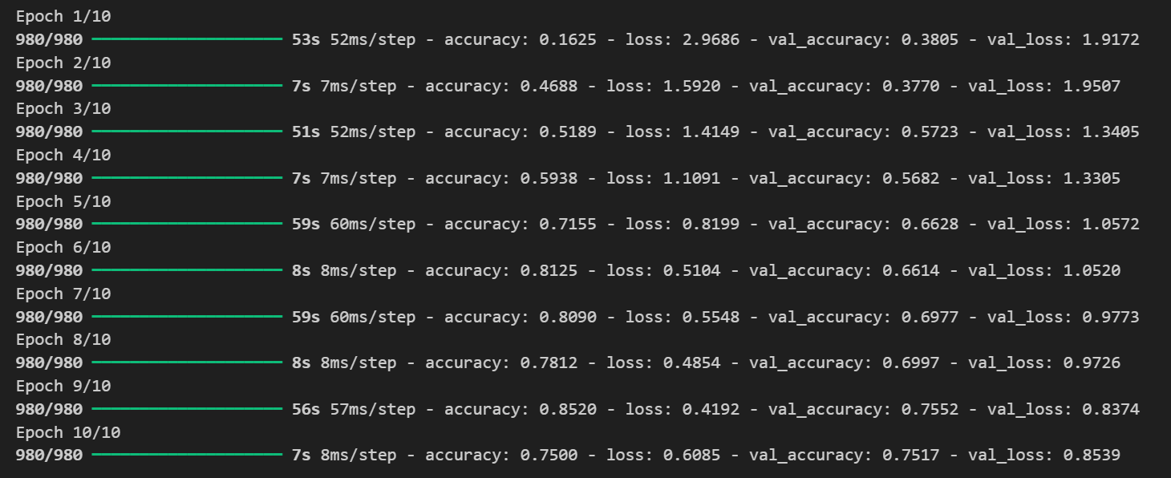
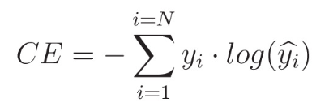
Results (10 Epochs of Training)
Notes:
Loss: Categorical cross-entropy loss:

Slide 9
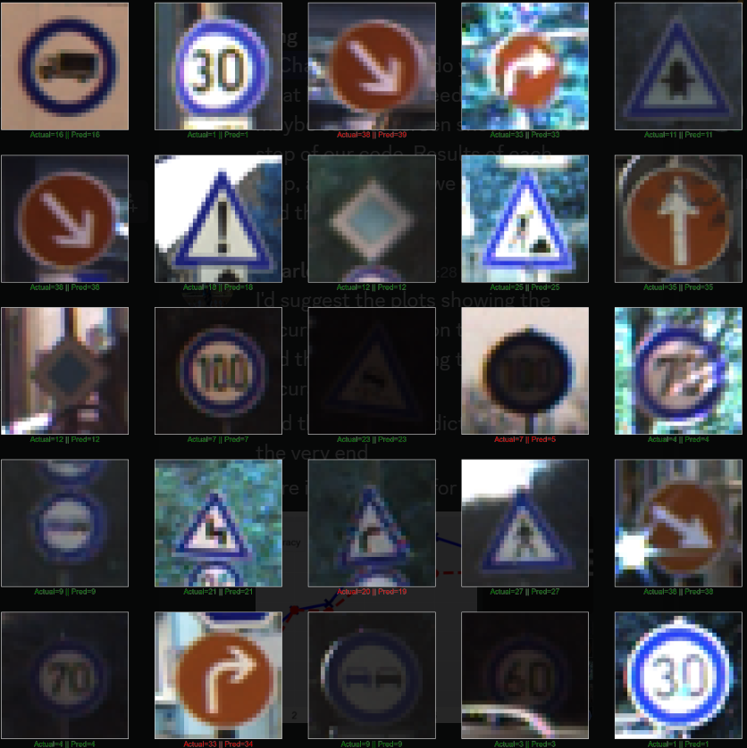
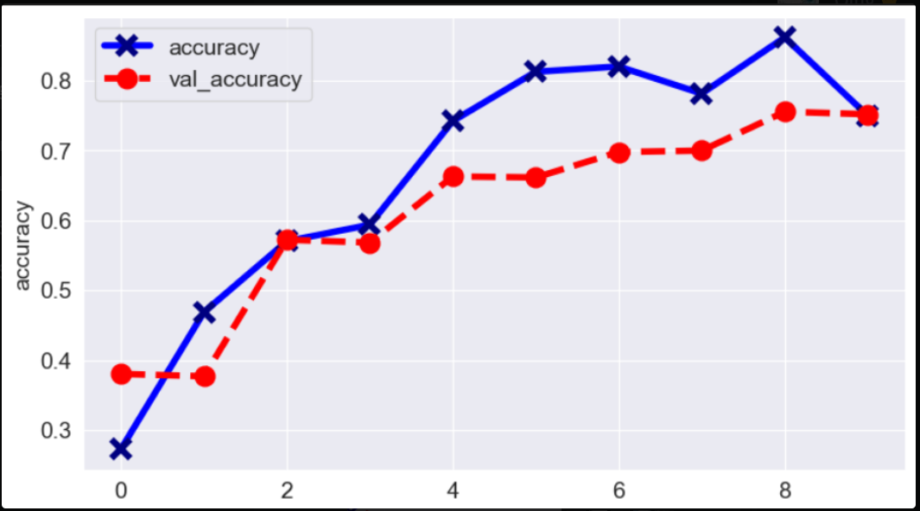
Results

Slide 10
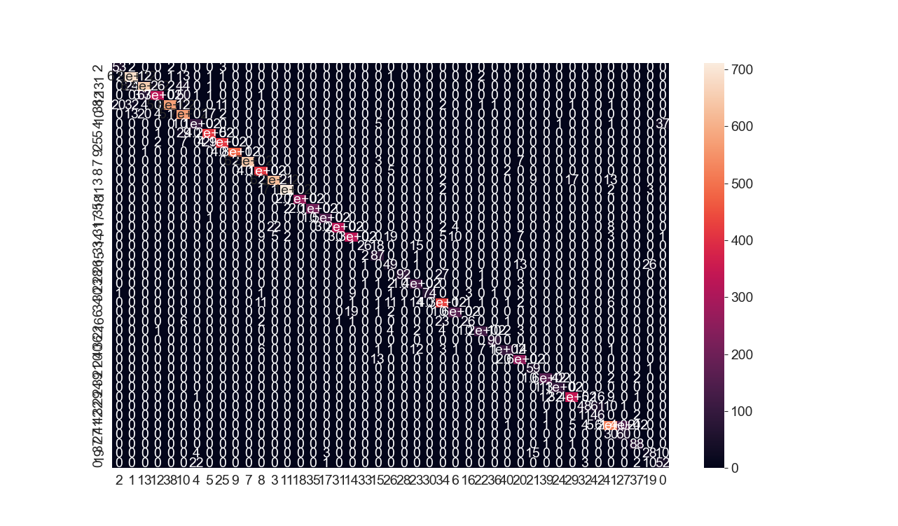
Results
Main diagonal shows correct classifications - generally high.
Low rate of misclassifications outside this diagonal

Slide 11
Final Thoughts
85% accuracy is good, but must be much more robust in real life.
Model must be able to respond to real-life situations, unexpected scenarios
Future steps:
More extensive data set
Much longer training time
Better fine-tuned parameters
Compatibility with video data

Slide 12
Questions?

Slide 13
References
German Traffic Sign Recognition Benchmark GTSRB <https://sid.erda.dk/public/archives/daaeac0d7ce1152aea9b61d9f1e19370/published-archive.html>
SlidesGo Presentation Templates
<https://slidesgo.com/>
Freepiks
<https://www.freepik.com/>
NN SVG
<https://alexlenail.me/NN-SVG/LeNet.html>
1
2
3
4

